Slide 1
Barriers to Effective Health Care for Disabled People: Signs of Progress in Medicine and Law
Prof. Mary Crossley
University of Pittsburgh School of Law
April 12, 2024

Slide 2
Roadmap
People with disabilities as a health disparities group
Barriers contributing to disparities
Physical barriers
Communication barriers
Knowledge barriers
Attitudinal barriers
Signs of progress
Greater legal clarity
Increased attention in medicine/public health
Continuing challenges

Slide 3
Health disparities
Defined by the CDC as preventable differences in the burden of disease, injury, violence, or in opportunities to achieve optimal health experienced by racial and ethnic minority groups and other groups of communities that are socially disadvantaged.

Slide 4
Disability health disparities
Compared to persons without disability, disabled persons in the U.S. …
Have shorter life expectancies
Are at greater risk of early onset of cardiovascular disease
Are more than twice as likely to be obese
Are more than three times likely to have diabetes
Are significantly more likely to have unmet needs (medical, dental, and prescription)
If a woman, are less likely to receive routine screening exams and likely to receive poorer maternity care

Slide 5
NIH designation
9/23 designation of people with disabilities as a health disparities population
increases funding for research on disability disparities
encourages inclusion of researchers and research subjects with disabilities

Slide 6
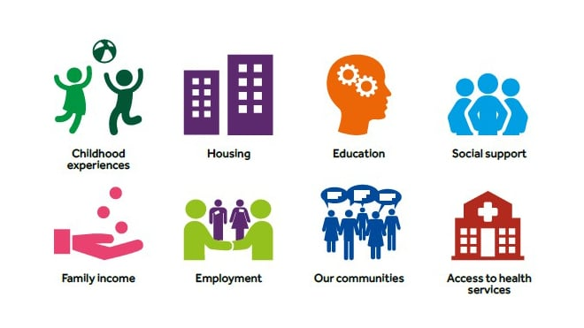
Contributors to disparities

Slide 7
Contributors to disparities: my focus today

Slide 8
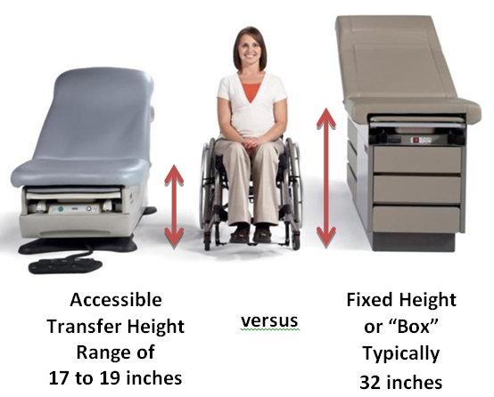
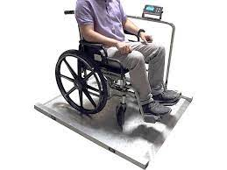
Physical barriers

Slide 9
Communication barriers to access
Oral communications without manual interpretation or videos without captions
Written communications that use small print or do not come in Braille or screen reader versions
Using long words and sentences and technical language

Slide 10
Knowledge barriers
Providers’ limited knowledge regarding legal obligations
Providers’ limited disability competence training

Slide 11
Knowledge barriers: legal obligations

Slide 12
Attitudinal barriers: Inattention to disabled patients’ perspectives

Slide 13
Attitudinal barriers: Providers’ beliefs and biases

Slide 14
Emerging signs of progress

Slide 15
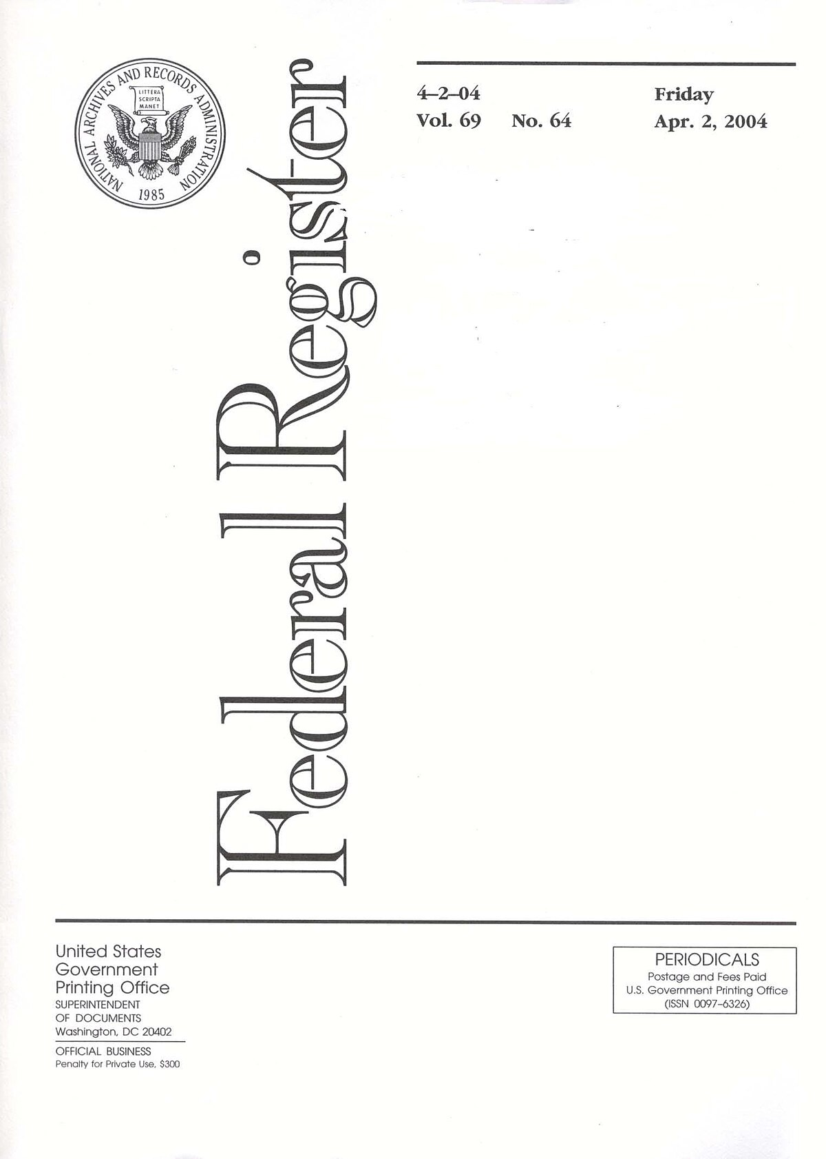
Proposed Justice Dep’t regulations (1/24)
Promulgated under Title II of ADA (applies to state and local gov’ts)
Sets out requirements for use of accessible medical diagnostic equipment (MDE), using standards crafted by Access Board

Slide 16
Proposed HHS Regulations (9/23)
Promulgated under §504 of the Rehabilitation Act (applies to recipients of federal funding)
Establishes enforceable accessibility standards for medical equipment (coordinated with DOJ proposed rule)

Slide 17
Proposed HHS Regulations re bias, devaluation, and segregation
Prohibits limiting or denying medical care based on
Biases or stereotypes about a patient’s disability
Judgments that a disabled patient will be a burden
Beliefs that life with a disability is of less value or not worth living
Limits use of value assessment methods placing lower value on extending lives of disabled people
Clarifies obligations associated with the “integration mandate”

Slide 18
Signs of progress: health professions
Federal medical research/public health agencies
Medical literature
Medical education

Slide 19
NIH Mission Statement: eliminating ableist language
Current: “To seek fundamental knowledge about the nature and behavior of living systems and the application of that knowledge to enhance health, lengthen life, and reduce illness and disability.”
Proposed: “To seek fundamental knowledge about the nature and behavior of living systems and to apply that knowledge to optimize health and prevent or reduce illness for all people.”

Slide 20
Attention to ableism in medical journals

Slide 21
Medical education

Slide 22
Continuing challenge: commodification of health care
Lack of reimbursement for interpreters, other aids
“Efficiency” expectations for providers → 15 minute visits

Slide 23
Emerging challenge: anti-DEI legislation applicable to health professions education
Anti-DEI laws can reach medical education
Proposed federal legislation would cut off federal funding to medical schools with DEI offices
Potential for administrative censoring
Application to anti-ableist education unclear

Slide 24
Questions?

