Slide 1
A Crosswalk of Common Ethical Challenges in Substance Use Disorder Treatment & Disability Ethics
Todd Harvey, MSN, RN, CARN
Programmatic Nurse Specialist, Addiction Medicine UPMC Mercy
Notes:
Enabling oneself to act ethically in these situations entails a process of growth… a process of unknowing to know… this requires a pause. This requires some humility. This requires some curiosity.
Plato and the cave…
The elephant and the four hands…

Slide 2
Objectives
Identify common ethical issues in the treatment of patients with Substance Use Disorder (SUD).
Identify the role stigma plays in treatment of SUD and disabilities.
Adapt three clinical behaviors or approaches to improve ethical treatment of patients with SUD.

Slide 3
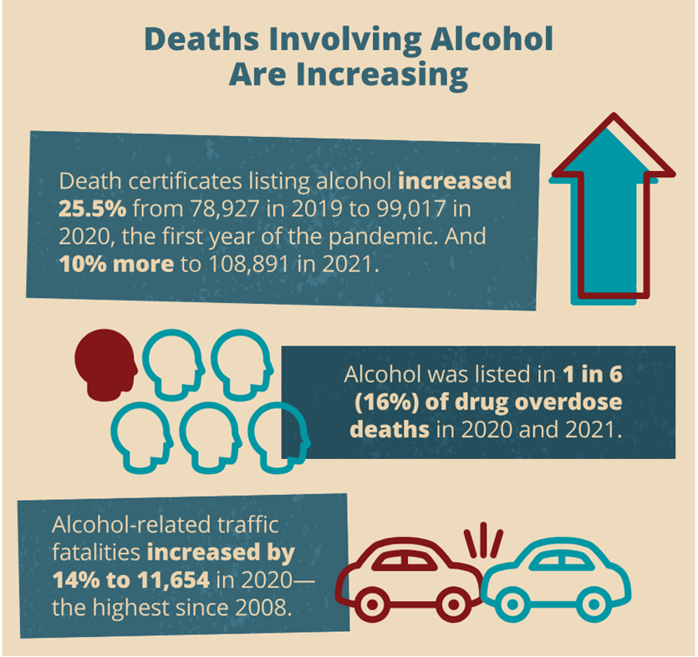
Substance Use Disorder in the US
Overdose epidemic (biggest headline)
105,452 overdose deaths in 2022
In PA, 5146 deaths in 2022
SUD rates in the overall pop
10% alcohol
8% opioids
5% marijuana
Polysubstance Use
Xylazine
Sedatives, stimulants
Tobacco/Nicotine
Notes:
As we dive in, I want to provide a brief overview of addiction and SUD crises happening in the US…. And here in SWPA.
OD deaths in PA- 78% are opioid-related (fentanyl). On average 14 people die each day in PA d/t drug overdose.
Through our daily clinical experiences, we know how pervasive SUD is in our communities. In fact, "every nurse is an addictions nurse", and every other clinican can likely make the same claim. Looking at statistics, According to data from the 2021 National Survey on Drug Use and Health (NSDUH), in general, substance use disorder impacts about 17% of the US population aged 12 and older (meeting DSM-5 criteria). It is important to note that 94% of these individuals did not receive any treatment (most people do not think they need any treatment). Individuals may be living with SUD to one or more substances, most frequent listed here.
Alcohol: one of the leading preventable causes of death in the US, about 10% of US adults living with AUD. Alcohol-Related Emergencies and Deaths in the United States | National Institute on Alcohol Abuse and Alcoholism (NIAAA) (nih.gov)
According to NIAAA, alcohol-related emergencies and deaths have been increasing since before and during the COVID pandemic. Alcohol has been listed in about 1 in 5 overdose deaths, including in Allegheny County, and alcohol intoxication has been present in 20% of completed suicides. Alcohol-related traffic fatalities....
Interestingly, reflecting on the pandemic, when all of the liquor stores and bars closed, those of us working in SUD anticipated a huge rush to withdrawal management services. This never happened! We underestimated our community. They were far savvier than we gave them credit, accessing alcohol from multiple other sources and actually staying away from hospitals and care sites for a few months.
In PA:
Opioids & Overdoses: About 8% of US adults living with any kind of OUD.
Our nation has reached a grim milestone, with overdose deaths surpassing the 100,000 mark in the most recent years, and continuing to stay above 100,000. In PA, on average, 14 Pennsylvanians die each day to drug overdose. Pennsylvania is one of the states with highest overdose mortality numbers and rates (4th and 9th respectively) Pennsylvania Overdose Data Brief 2022.pdf (pa.gov)
Fentanyl, synthetic opioids- contributed to 78% of all fatal overdoses in PA.
Xylazine- contributed to death in 32% more fatal overdoses compared to 2021.
Overdoses are increasing among African Americans and other communities of color, while decreasing among whites. On average, highest among males, and ages 35-44.
Benzodiazepines (less than 1% of US pop)
Benzodiazepine use in the U.S. is higher than previously reported and misuse accounted for nearly 20% of use overall (2019). Use among adults 50–64 has now exceeded use by those ≥65.
Stimulants (less then 1% of US pop)
Stimulant use is on the rise in the United States. According to the 2018 National Survey on Drug Use and Health, an estimated 5.1 million people aged 12 or older misused prescription stimulants in the past year; approximately 1.9 million people aged 12 or older used methamphetamine in the past year with significant increases in use in those aged 26 and older; and 5.5 million people aged 12 or older used cocaine in the past year.1 Overdose deaths linked to psychostimulants increased approximately 22 percent from 2017 to 2018 and have increased more than three fold over the past five years. Deaths from cocaine, which can be laced with fentanyl, increased by 5 percent from 2017 to 2018 and are more than double what they were in 2015.2 The combination of all types of stimulants with unknown amounts of fentanyl increases the risk of overdose and overdose death substantially
Present in about 45% of PA overdose deaths in 2022, almost always co-present with an opioid, usually fentanyl.
Over 5 million Americans reported current cocaine use in 2020, which is almost 2% of the population.1 (CDC)
Cocaine-involved overdose death rates in the United States decreased from 2004 to 2012 but began increasing again in 2012. Non-Hispanic Black people experienced the highest death rate for overdoses involving cocaine in 2019.2 From 2020 to 2021, cocaine overdose death rates increased by nearly 22%, with more than 24,000 Americans dying in 2021 from an overdose involving cocaine.
In 2020, 2.5 million Americans aged 12 or older reported having used methamphetamine in the past year.1 From 2015-2018, an estimated 1.6 million U.S. adults aged ≥18 years per year on average, reported past-year methamphetamine use.5 Among adults who used methamphetamine during this time:
53% met diagnostic criteria for methamphetamine use disorder. Less than 1 in 3 of those with methamphetamine use disorder received substance use treatment in the past year.
3% reported injecting methamphetamine in the past year.
Co-occurring substance use and mental illness were common.
ED visits associated with an SUD: 1 in 13
Inpatient hospitalizations associated with an SUD: 1 in 9
Tobacco use is the number one cause of preventable death in the United States. Look for introducing patients to nicotine replacement, and tobacco cessation resources.
What is the most common substance leading to the most deaths and negative health outcomes in the US? Tobacco.
IS THIS A MORAL or a PUBLIC HEALTH ISSUE??? The way we treat it often still feels like we frame it as a moral issue and NOT a public health issue.

Slide 4
American Society of Addiction Medicine (ASAM)
Addiction is a treatable, chronic medical disease involving complex interactions among brain circuits, genetics, the environment, and an individual’s life experiences. People with addiction use substances or engage in behaviors that become compulsive and often continue despite harmful consequences.
Prevention efforts and treatment approaches for addiction are generally as successful as those for other chronic diseases.
Adopted by the ASAM Board of Directors September 15, 2019. https://www.asam.org/Quality-Science/definition-of-addiction
Notes:
This is the ASAM definition. Take a moment to read for yourself.
When I am talking about patients living with addiction, I am generally talking about this…. I tend to use SUD and addiction interchangeably….
What stands out, and reflects current scientific understanding of addiction? 21st century thinking about this, though remnants of 20th century thinking, and attitudes remain prevalent.
-Treatable. Recovery is possible.
Chronic. Treatment plans can be similar to those of other chronic diseases: hypertension, diabetes. Experiencing a relapse is not a moral failure. It is natural outcome of a chronic disease that takes a lot of energy and skill to manage.
Medical. Those of us in medicine have a significant role to play in caring for the patients- their brains, their cravings, the impacts on the rest of the body’s systems.
-brain disease- someone’s brain functioning is altered while in active substance use, which can continue to have effects even after intoxication and withdrawal have been successfully managed.
Some are more genetically vulnerable than others
Whether that gene is expressed can depend on numerous environmental triggers and life experiences: we have to be holistic in our approach- it takes physicians, nurses, social workers, peers, families and communities to optimize recovery.
Addiction is not something we create or cure in the hospital. It develops over long periods of time where all these interactions come into play. It is managed and treatable over long periods of time as well.
20th century thinking: We also often treat addiction like it is different, a disease purely out of someone’s own choice or self-doing; ignoring their baseline brain functioning, their genetics, their environment and experiences. Addiction is no more a result of choices than other chronic diseases.
So, based on this understanding of addiction, we wanted to talk to you today about how we are striving to address addiction here at Mercy, and your role in this work.
Bottom line here: drugs and alcohol change the brain with prolonged exposure.
Exact definitions vary depending on source
American Psychiatric Association: “A condition is which there is uncontrolled use of a substance despite harmful consequence”
DSM-IV*: “A cluster of cognitive, behavioral, and physiological symptoms indicating that the individual continues use of the substance despite significant substance-related problems”
SAMSHA: “Recurrent use of alcohol and/or drugs causing clinically significant impairment”
For ethics presentation, I like this definition because it gives some insight into the potential thickness of a root(s) to addiction, allows trauma (physical and emotional) to be seen… and to see the many strands of roots feeding up into a tree.. Into a being… we cannot see the roots, all we see is a person with incomprehensible behaviors….
Please hold the image of this root in your mind
Is this a moral issue or a public health/medical issue?

Slide 5
Physical Dependence vs. Substance Use Disorder
Physical Dependence | Substance Use Disorder
Not a disease | Classified as a disease
Tolerance | Tolerance
Withdrawal | Withdrawal
Use of medication relieves w/d symptoms | Compulsive use
Uses as prescribed, controls use | Inability to control use
 | Uncontrollable cravings
 | Using despite consequences
Notes:
I just want to clarify a few terms, so you all have a better picture of the patients I work with at Mercy. Apologies if I use Addiction and Substance Use Disorder interchangeably. Another concern, Dependency, is not the subject of my presentation here. It is not considered a disease, despite the cessation of medication often causing dramatic consequences, such as withdrawal.
Withdrawal… for those who do not work in hospitals, or who missed the 90s film Trainspotting… for opioids- is your worst flu times 100, for benzodiazepines, very vulnerable to seizures and crushing anxiety weeks to months after stopping use, and for alcohol, potentially fatal in its most complicated presentation of delirium tremens.
Explain: Not everyone who uses an Opioid or a medication with dependence potential is living with an addiction. There are many people who take pain prescriptions, as prescribed, and are able to move forward with their life and daily needs when the prescription(s) are finished.
Individuals with physical dependence may be at risk for developing an addiction, or an SUD. A life stressor may occur, and one finds themselves

Slide 6
Addiction in Hospitals
Substance Use Disorder
1 in 11 ED visits,
1 in 9 hospitalizations
Despite frequent contact with healthcare, most patients with SUD are not engaged in any type of treatment. (get percentage)
Circumstances that challenge clinicians:
Withdrawal
Pain management
Behavioral “management”
Use while hospitalized
Leaving against medical advice
Notes:
With an exploding SUD epidemic in the U.S., hospitals are essential, a “critical touch point’ in beginning to address the problem.
When patients living with SUD come to hospitals, generally SUD is not their chief complaint. They come to hospitals for traumas, infections, GI problems, strokes, overdoses. These may be opportune or inopportune times to touch base with someone about abstinence or recovery, but it is always an opportune time to talk to someone about their health goals. We often fail to meet this opportunity.
In these scenarios, often caring for patients with SUDs will greatly challenge our standard clinicians (everyone from the physician to the nurse to the physical therapist.
What do we not do well?
Manage withdrawal.
Manage pain.
Make the environment one that is inclusive of folks with SUD…

Slide 7
SUDs & Disabilities
Commonalities

Slide 8
SUD & Disabilities
ADA: Addiction is a disability
Disproportionate burden of SDH
Experience of healthcare
Intersectionality
Field of medicine is social.
Biases, prejudices.
Notes:
To start, according to the Americans with Disabilities Act… addiction is a disability due to the impairment of brain and neurological functions.
People living with a disability or a substance use disorder are more likely to bear the negative burdens of social determinants of health compared to the general population. Systemic and structural issues are that people living with disabilities or SUDs are more likely to live in poverty, have housing challenges, experience unemployment… (?)
Both people with disabilities or substance use disorders report less access and less satisfaction with healthcare.
Disabled people encounter common social, physical and attitudinal factors that hinder their health outcomes in terms of access to services and quality healthcare. Many preventive health services were identified as either inaccessible or not meeting the needs of disabled people.
Patient experience commonalities…
Dissatrisfied with care… are the drivers the same? Ableism &
Is everything “wrong” associated with your disability or your SUD?
Wheelchair user- “well you sit all day”
Ableism… … pt not seen as a credible expert on their body, their experience…
Disability paradox… rate of quality of life is lower than persons with disabilities rate their lives themselves
Can I work in intersectionality… a synergistic layering of social and economic disadvantages in terms of race, gender, sexuality, class… identities that operate interdependently of one another in influencing one’s opportunities and access in societies structured by patriarchy, racism, heteronormativity, etc.
Aligns with minority stress theory in healthcare…
How do we know what we know about patients, and certain categories/diagnoses of patients?
Language- Euphemisms, stigmatizing language; isolating… that is you, and I don’t see your world…
Pathophysiology of the disease… ableism/epistemic derailing….
The field of medicine is fundamentally social and therefore the knowledge is also shared and interpreted through the social lens
Not sure who wrote this but it’s in my notes from the article I just sent
On the ableism schema, “being disabled means being worse off by virtue of one's disability, and so even information that is not clearly related to an impairment can easily become a reason for potentially any medical issue.” p 217
Disability paradox: people without disabilities rate quality of life in disabled people lower than those with disabilities tend to 220
225 - “a root cause of ableism is medicine’s own understanding of disability as an objective lack rather than as a diverse set of phenomena that are thoroughly socially mediated”

Slide 9
Ableism & SUD Stigma
Ableism
The assumption that disabled people are inherently less capable overall, less valuable in society, should have less personal autonomy than is ordinarily granted to people of the same age
Stigma
Negative attitudes or discrimination toward someone or a group based on a distinguishing characteristic, with roots in a lack of understanding or fear
Both hinder patient-provider communications.
Notes:
Focusing in on two unique experiences and how they both might shape the healthcare experience, and particularly the social aspect of it:
Ableism for patients with disabilities
Stigma for patients with SUDs/Addiction
Ableism
Social habits, practices,
regulations,
laws & institutions
Stigma (Volkow 2021)
And Pro-A study… anonymous web-based study of over 26,000 Americans shows that stigma of recreational drug use is incredibly high:
71% of respondents believed that society at large considers individuals who use drugs problematically to be outcasts or non-community members
74% of respondents believed that society at large views individuals who use drugs problematically as somewhat, mostly, or entirely responsible for their drug use
73% of respondents believed that society at large views individuals who are dependent on drugs as having moderate, low, or no chance of maintaining recovery
Creates a power dynamic that exploits, controls and excludes, often subtly, hidden by cultural norms
Stigma represents the collective negative attitudes or discrimination toward someone or a group based on a distinguishing characteristic, such as recreational drug use. These attitudes have deep roots often from historical periods with less understanding and fear of the group. Addiction stigma stems from historical narratives built on racial, ethnic and class inequalitities. Stigma thrives by becoming embedded in institutional norms, pervasive messages in mass media, and through stereotypes. Even those within the group may internalize these negative attitudes.
Dr. Nora Volkov, the current director of the National Institute on Drug Abuse at the NIH argues that stigma has interrupted our ability to address substance use disorder/addiction at each possible stage of health maintenance: prevention, intervention, treatment. Stigma makes topics more difficult to discuss as it impedes conversation. The language we have around stigmatized topics is often evolving, but since these are stigmatized topics the existing language often has roots in systems of oppression and inequalities.

Slide 10
Stigma & Addiction/SUD
How does stigma impact our ability to treat addiction?
Public stigma
Society’s negative attitudes that promote isolation.
“I don’t know what to say”
Structural stigma
Institutional practices.
Self-stigma
Individuals internalize and accept negative stereotypes, turns a “whole” person into someone who feels broken.
Stigma manifests itself in language.
(Volkow, 2020)
Notes:
Stereotypes
Institutional norms
“I don’t know what to say”
Public stigma- overall negative attitudes contribute to a person living with addiction to isolate, which is the opposite of connection.
As a nurse educator here at Mercy, I have often heard, “I don’t know what to say” when someone shares something difficult with me, such as their experience of addiction and their past or current traumas. Often, “you don’t know what to say”, or you do not have words, because of pervasive stigma, by not having had opportunities to talk about difficult topics where our knowledge is evolving. It is not your fault. Often we must learn how to communicate in these situations due to the silence of our society on issues such as addiction. Overcoming this challenge takes effort and is a skill that you can develop.
Structural stigma- institutional practices that result in individuals moving through our society’s systems differently due to having a stigmatized condition. For addiction, we can see this in our own hospital, as we seek to honor patient confidentiality, we have to have locked nursing units for patients being treated with addiction. WE have more “release of information” forms we have to sign before communicating with others about their medical condition and social needs.
If you love paperwork nightmares, try getting a patient on methadone for OUD into a skilled nursing facility.
Self stigma- You may hear someone referring to themselves as an “addict” or an “alcoholic”, and may embrace that label, which can ultimately have a negative impact on their own self esteem and agency.
One way stigma can be felt is through the language of those with power, such as the healthcare provider in a patient/provider relationship.
In my two years working at Mercy as an Addictions nurse, I have heard that patients living with addiction:
“You are taking up someone else’s bed, there is a person with a gunshot wound who needs this bed”: Implication- Some diseases are more deserving of a hospital bed than others. Yet this puts a social issue of not having enough beds to care for patients on the shoulders of a singular patient, who also needed care.
“They have done this to themselves.” Implication- Individuals living with addiction are somehow more responsible for their illness than all others.
“These patients don’t belong on this unit.” Implication-
“These patients aren’t sick.” Implication-
I overheard a nurse talking with physical therapist outside of patient room. Patient says to nurse, calmly, “you don’t know my problems”. RN responded to PT “Yes I do. You OD’d”.
(Volkow 2020)
Stigma and the Toll of Addiction | NEJM
Addressing the Stigma that Surrounds Addiction | National Institute on Drug Abuse (NIDA) (nih.gov)

Slide 11
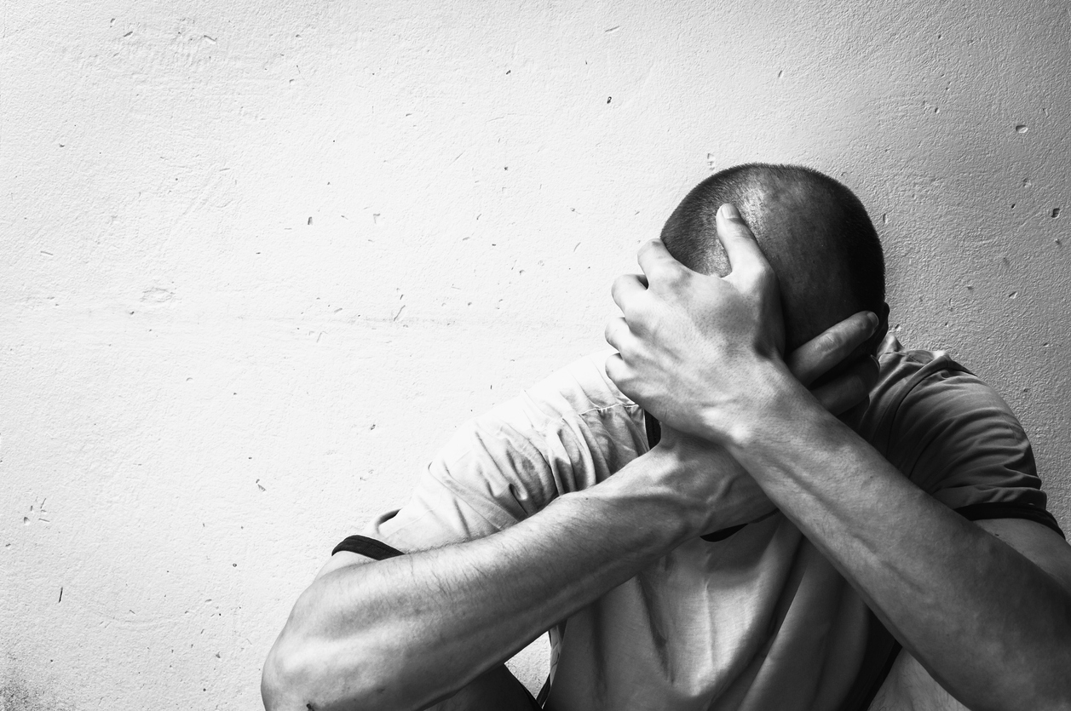
To what effect?
Reduces willingness to seek treatment.
Stigmatizing views lead others to feel pity, fear, anger.
Stigmatizing views instill a desire for social distance from people with an SUD.
Stigmatizing language negatively influences health care provider perceptions of people with SUD.
Stigmatizing language negatively impacts the care they provide.
(Volkow, 2020)
Notes:
Volkov 2021
Feeling stigmatized can reduce the willingness of individuals with SUD to seek treatment.
Stigmatizing views of people with SUD are common; this stereotyping can lead others to feel pity, fear, anger, and a desire for social distance from people with an SUD.
Stigmatizing language can negatively influence health care provider perceptions of people with SUD, which can impact the care they provide.
Stigma associated with addiction is often embedded in our language and attitudes, and at times we do not even recognize this. Patients pick up on verbal and non-verbal cues, shaping their experience of our care and their experience of us as individuals. Research suggests that patients living with addiction may delay or not seek care altogether due to their experiences of perceived stigma in medical settings (Paquette, Syvertsen and Pollini 2018).

Slide 12
Patient Concerns & Fears
Withdrawal
Untreated pain
Judgment and stigma
Fear of relapse if re-exposed to opioids (among those in recovery)
(Quinlan & Cox, 2017)
Notes:
When it comes to the hospital, even though there are many patients with SUDs in the ED and who are admitted inpatient, there is hesitation on behalf of patients with SUD to come into hospitals. Let’s remember what I said we don’t do very well from a clinician’s perspective. Here’s what patients fear we do not do well…
Patients living with SUD actually have a lot of fear when coming to the hospital. It is well-known to people who use substances that they can expect to (either based on past experiences or experiences of friends and family) perceive/experience to be treated negatively in hospitals. Evidence supports this. What do they fear? Withdrawal. Untreated pain. Judgment/stigma. Fear of relapse.
Withdrawal and pain, when managed clinically, have both objective and subjective components. Often the subjective component allows for clinician discretion…

Slide 13
ANA Ethical Principles
Provision 1
“The nurse practices with compassion and respect for the inherent dignity, worth and unique attributes of every person.”
1.1 Consider the needs, respect the values….
1.2 When a patient’s choices are risky…
1.3 Optimal nursing care… reflects the patient’s own values.
1.4 Respect the right to self-determination.
(ANA, 2015)
Notes:
Ableism & Stigma negatively impact patient access to healthcare services. How do we act ethically to address this?
Where I see our biggest opportunity for growth, change, impact on patients:
Empowerment vs paternalism
Cultivating dependency vs autonomy (is the patient capable of stating personal goals?) Do not obstruct their actions. (Patient wanting to go AMA)
Not trusting the patient.
Beneficence (promotion of goodness, acting on love and compassion)
Autonomy and beneficence can compete..
This is not exhaustive- there are other ethical issues.
Confidentiality
Self-disclosure
Stigma creates a power dynamic….
Addressing Drug Use & Recovery Stigma: - PRO.A
Look at ANA Code of Ethics- provision 1, 2,
1.2- Relationships with patients
1.3 Nature of health
1.4 Patient right to self-determination
2.1 Primacy of patient’s interest

Slide 14
Mistrust of the SUD Patient
Patients with SUDs are “med-seeking”.
Underlying attitude: patients living with SUD cannot be trusted to report on their own symptoms
Patients going outside.
Underlying attitude: patients living with SUD cannot be trusted to make their own decisions
Patient going AMA.
Underlying attitude: patients living with SUD cannot be trusted to make their own decisions
Patient’s choice of surrogate decision maker.
Underlying attitude: patients living with SUD cannot be trusted to make their own decisions
Notes:
The scenarios are endless where we are challenged to act ethically while providing nursing care in the hospital. A patient’s autonomy is frequently in question, and a SUD patient’s fears and concerns are frequently realized.
Case Study: “Miracle workers” in getting people into “rehabs”.

Slide 15
What we can do about it.
Self, Connections, Services

Slide 16
1. Work on Ourselves.
Self-awareness/recognizing personal biases
Expand the narrative.
Recognize the impact of your language.
Self-judgement and evaluation
Expand your thinking on what a positive outcomes might be
“It hurts to come in to work knowing that you cannot do what you want to do for patients.”

Slide 17
Embrace a menu of successful outcomes of hospitalization for patients with SUDs.
Direct transfer to inpatient treatment
Treatment
Medications for SUD initiated
Outpatient treatments
Connection to Community
12 step, peers, case management
Harm Reduction Tools Provided
Test strips, naloxone
Harm Reduction Education Provided
Hygiene, nutrition
+
Add to the repository of + experiences with healthcare
Notes:
How do we know we are acting ethically for each patient living with SUD?
Here’s a pyramid of ethical treatment outcomes, driven by a patient’s stated needs…
What patients have qualitatively reported is important to them in a hospitalization:
Hospitalization can be a wake up call, and quick, coordinated access to treatment is critical.
Hospitalization often can interrupt use, and demonstrate to patients that they can continue to cease use.
Importance of choice. (It can’t be treatment or nothing.)
Patients receiving harm reduction services in the hospital have reported that the AMCT had positive impacts overall, including declines in substance use, enhanced mental and emotional wellbeing, and improved socio-economic circumstances.
Treatable and chronic- AND recovery is the expected outcome. HOWEVER…. If we look at the hospital, and each hospital admission…

Slide 18
Use person-first language.
Addict to “person living with addiction”
Drug abuser to “Joe”
Alcoholic to “Erika, living with alcohol use disorder”
Med-seeking to “Todd, a patient who has unmet needs”
Frequent flier to “Mrs. Smith”
Notes:
What’s the first step we can do to add to the repository of positive experiences?
We can begin to change our language.
Using person-first language is step one in showing dignity and respect.
Person-first language places emphasis on people rather than their diagnosis or condition (e.g. “person with schizophrenia” vs. “schizophrenic”, “person with a substance use disorder” vs. “addict”).iv By utilizing person-first language, an individual is no longer defined by their condition. The person is placed first with the condition being secondary, which helps to eliminate stereotypes and biases.

Slide 19
Frequent fliers → Familiar faces
Notes:
Here is a table of stigmatizing words and phrases vs words and phrases that have been found to foster trust and connection.
This language establishes a firm foundation from which to build a therapeutic relationship. This takes purposeful practice to make it second nature.
Be aware that patients use stigmatizing language but note that they are not giving care providers permission to do the same. As care providers, our responsibility is greater. Our duty is to promote a world view for our patients where they do not see themselves as stigmatized members of society, but rather as individuals who are living with addiction or in recovery. During inpatient stays, we have a brief window of opportunity to plant these seeds of thought.

Slide 20
2. Improve our connections.
Clinical curiosity
Humility
Affinity bias
(Hari, 2015)
Notes:
Building on changing our language, there is more we can do to cultivate connections with the people in our care. We have to think about how we are cultivating a relationship with them.
Johann Hari wrote a great book about addiction in the United States, and spoiler alert, one of his major conclusions is that the opposite of addiction is connection.
“I don’t know what to say when patients share something difficult with me”…. Addiction, homelessness…
It’s ok not to know exactly what to say. We can’t change the course of events. But what we can say is “thank you for sharing that with me. For trusting me. If it is ok, I can share your story with other members of the care team so we can find a way to help.”
We are not trained in making connections with patients, particularly those who may have different experiences than ourselves. Both medical school and nursing school fail to adequately educate students on substance use disorders, and belief in the moral model, and that patients with SUD may be “lacking’ willpower or experiencing a moral failure tend to be pervasive among care providers, particularly when they are stressed and overworked.
If we allow ourselves to see our patients as our neighbors and our teachers… what could they teach us and how could they change us?

Slide 21
3. Advocate for services.
Inpatient Hospital
Consults
Specialized consult teams decrease stigma and offer evidence-based treatment.
Increases trust in hospitals and physicians.
Peer Navigators
In the community
Possess a basic knowledge of low threshold services available to patients.
(Englander, 2022)
Notes:
Amidst an unrelenting substance use disorder (SUD) epidemic, SUD-related hospitalizations are rising across the USA.1–4 One in nine hospitalized adults has SUD.5 Most hospitalized patients with SUD are not engaged in addiction care or seeking treatment at admission6,7 ; yet hospitalization is a critical touchpoint to engage and intervene with people with SUD.8,9 Hospital-based SUD care can improve patient and provider experience,10,11 increase trust in hospital physicians,12 increase adoption of evidence-based treatment,13 increase post-hospital SUD treatment engagement,7,14 reduce substance use severity,14,15 reduce death,16 and transform health systems to be more healing for people who use drugs.11 Despite its effectiveness, few hospitals offer evidence-based SUD care. (Englander et al 2022)

Slide 22
Concluding Thoughts
Don’t judge a book by it’s cover.
Be humble.
Aim to change.
Get to know other’s stories.
Notes:
What might all of this have to do with patients with disabilities? And taking ethical action?
This goes back to ourselves, and ensuring that we act as ethically as we can. The power resides within us. Lead by example for your colleagues.
1. The cover… in the hospital could be the diagnosis, the nurse report you get at the beginning of your shift. This is not enough information to determine how you can care for someone.
2. Be humble. Don’t assume you know someone else’s experience.
3. Aim to change. Adapt your language. Adapt your practices.
4. Any time we meet a patient for the first time, caring for them has to start with initiative in getting to know their story.
We don’t see the whole story. We are incapable of seeing it.
Acknowledge this.
Get curious.
For nurses, this approach does take time. But it is a process of working smarter, not harder. Leverage your team, talk to others and put the story together as a team so that you can all offer the best care to the patient.
For those of you outside of healthcare, these lessons easily translate into all aspects of our lives. If we are to ever begin to overcome our current brokenness, we are going to do so together, by expanding our access to other’s stories.

Slide 23
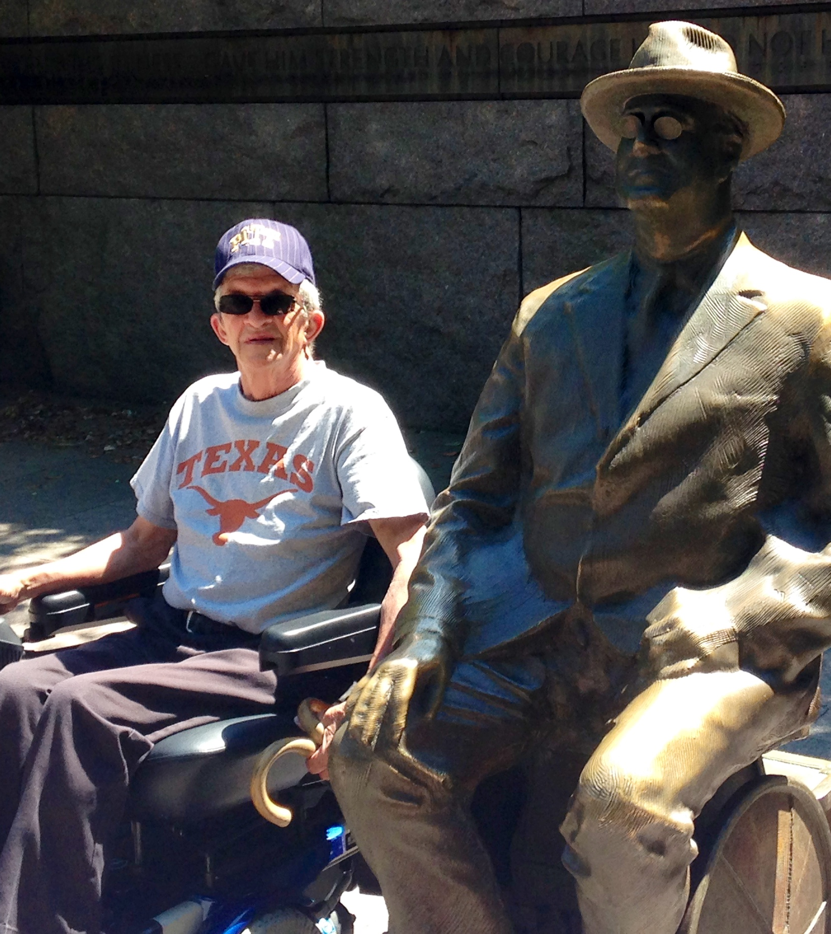
My family’s story
Notes:
Thank you for inviting me to speak today. This is a special opportunity for me. Living with a disability has framed my entire life and deeply impacted my family’s daily existence. This is my father, alongside FDR at the monument in DC. My father was born with Spina bifida. He relied greatly on healthcare his entire life, but was not always confined to a wheelchair. As a result of a poor outcome of one of many surgeries in the early 1980s he spent the remaining 40 years of his life with chronic pain, using canes and then a wheelchair to go from place to place. My father was dependent on opioids for pain management for more than a decade. My father’s life was a master class on grace and grit. He never showed his anger. He taught me….. Never to let anyone else define you or to allow their expectations of you to limit you. Do not assume. Look out for those who may not fit the standard mold. I think he would be very proud today.

Slide 24
References
American Nurses Association (2015). American Nurses Association Code of ethics for nurses with interpretive statements. Silver Spring, MD
Englander, H., Jones, A., Krawczyk, N., Patten, A., Roberts, T., Korthuis, P. T., & McNeely, J. (2022). A taxonomy of hospital-based addiction care models: a scoping review and key informant interviews. Journal of general internal medicine, 37(11), 2821-2833.
Hari, J. (2015). Chasing the scream: The first and last days of the war on drugs. Bloomsbury Publishing USA.
Hoover, K., Lockhart, S., Callister, C., Holtrop, J. S., & Calcaterra, S. L. (2022). Experiences of stigma in hospitals with addiction consultation services: A qualitative analysis of patients' and hospital-based providers' perspectives. Journal of substance abuse treatment, 138, 108708.
Hyshka, E., Morris, H., Anderson-Baron, J., Nixon, L., Dong, K., & Salvalaggio, G. (2019). Patient perspectives on a harm reduction-oriented addiction medicine consultation team implemented in a large acute care hospital. Drug and Alcohol Dependence, 204, 107523.
Janz, H. L. (2019). Ableism: the undiagnosed malady afflicting medicine. Cmaj, 191(17), E478-E479.
Mitchell, R. J., Ryder, T., Matar, K., Lystad, R. P., Clay‐Williams, R., & Braithwaite, J. (2022). An overview of systematic reviews to determine the impact of socio‐environmental factors on health outcomes of people with disabilities. Health & social care in the community, 30(4), 1254-1274.
Park, J. N., Rouhani, S., Beletsky, L. E. O., Vincent, L., Saloner, B., & Sherman, S. G. (2020). Situating the continuum of overdose risk in the social determinants of health: a new conceptual framework. The Milbank Quarterly, 98(3), 700-746.
Quinlan, J., & Cox, F. (2017). Acute pain management in patients with drug dependence syndrome. Pain reports, 2(4), e611.
Reynolds, J. M., & Peña-Guzmán, D. (2019). The Harm of Ableism: Medical Error and Epistemic Injustice 1. In Ethics and Error in Medicine (pp. 167-199). Routledge.
Volkow, N. D. (2020). Stigma and the toll of addiction. New England Journal of Medicine, 382(14), 1289-1290.
Vu, M., Li, J., Haardörfer, R., Windle, M., & Berg, C. J. (2019). Mental health and substance use among women and men at the intersections of identities and experiences of discrimination: Insights from the intersectionality framework. BMC public health, 19, 1-13.

Slide 25
Thank you!
Contact:
Todd Harvey
harveytw@upmc.edu

